Slide 1
Open Sesame
Micheal Hatch & Philip Vickers

Slide 2
AGENDA
Introduction
Primary goals
Schedule
Project Requirements
Architecture and Design
Website
Questions

Slide 3
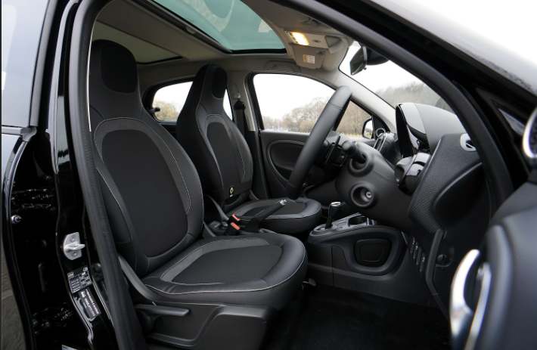
INTRODUCTION
How many times have you wished you had an extra hand when getting into your car? Well, wish no longer with Open Sesame. A voice activated App that opens and closes your car door for you.

Slide 4

PRIMARY GOALS
Hands Free Operation
Communication between App and Vehicle
Safety Features

Slide 5
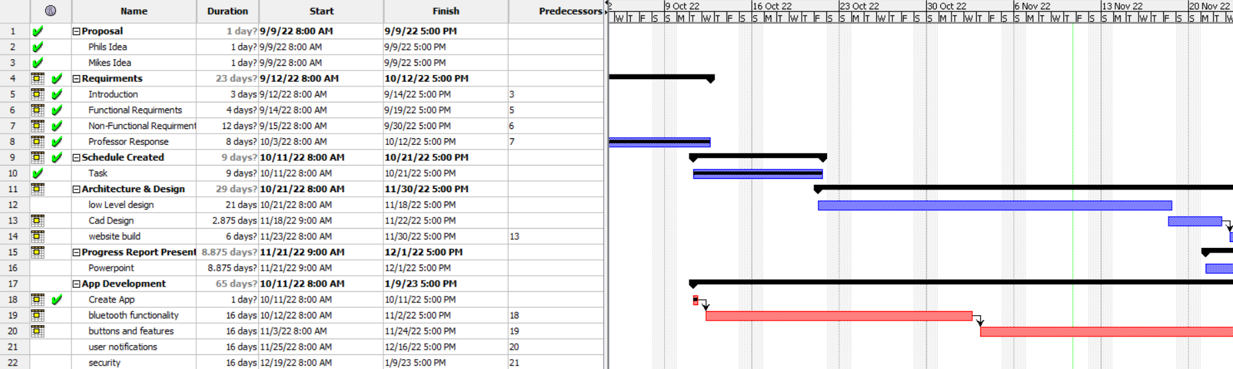
Schedule
On Track
Not a linear project

Slide 6
Project Requirements
Functional Requirements​ | User Action | Product Action | Safety Conditions | Project Requirement meet.
Door Opens using handheld device. | The user says, "Open the right front door." | A blue tooth signal is transmitted to the car and the computer opens the right front door. | Parking Brake must be applied. Car must be parked. | Yes
Door Closes using handheld device. | The user says, “Close the right front door." | A blue tooth signal is transmitted to the car and the computer opens the right front door. | Parking Brake must be applied. Car must be parked. | Yes
Door Blocked while opening. | Determine what obstruction is present and remove it if necessary. | Upon removing the blocking item and ensuring all safety measures have been implemented. | Object is removed, parking brake applied. | Yes
Door Blocked while closing. | Determine what obstruction is present and remove it if necessary. | Upon removing the blocking item and ensuring all safety measures have been implemented. | Object is removed, parking brake applied. | Yes

Slide 7
Project Requirements
Non-Functional Requirements​ | User Action | Product Action | Safety Conditions | Project Requirement meet.
Door Opens using handheld device. | The user says, "Open the right front door." | A blue tooth signal is transmitted to the car and the computer opens the right front door. | Parking Brake must be applied. Car must be parked. | Yes
Door Closes using handheld device. | The user says, “Close the right front door." | A blue tooth signal is transmitted to the car and the computer opens the right front door. | Parking Brake must be applied. Car must be parked. | Yes
Door Blocked while opening. | Determine what obstruction is present and remove it if necessary. | Upon removing the blocking item and ensuring all safety measures have been implemented. | Object is removed, parking brake applied. | Yes
Door Blocked while closing. | Determine what obstruction is present and remove it if necessary. | Upon removing the blocking item and ensuring all safety measures have been implemented. | Object is removed, parking brake applied. | Yes

Slide 8
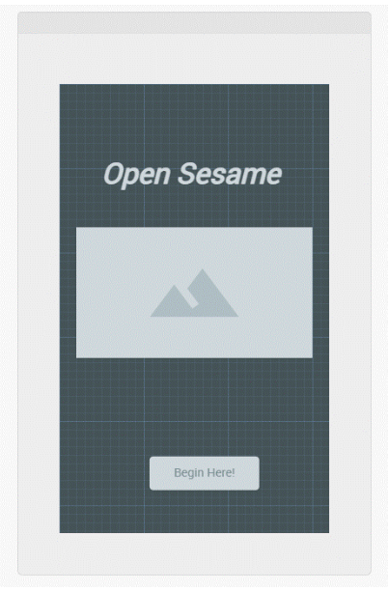
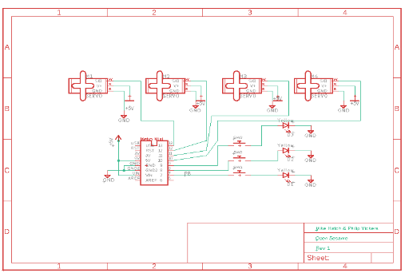
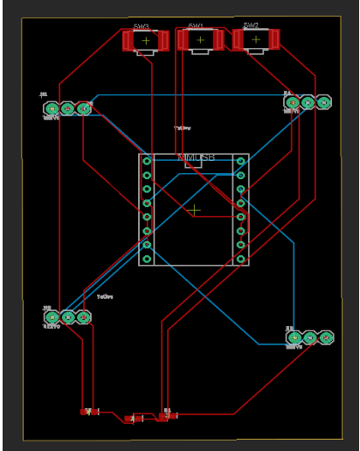
Architecture and Design
User Interface
Schematic
Circuit Board

Slide 9
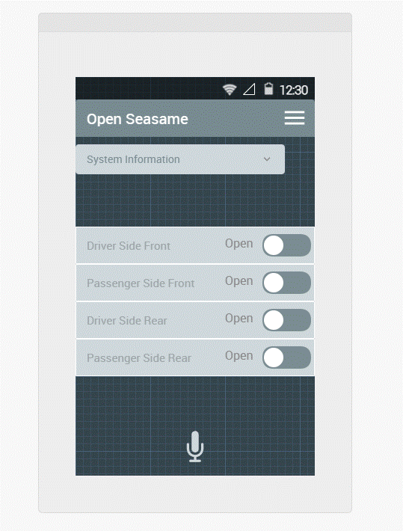
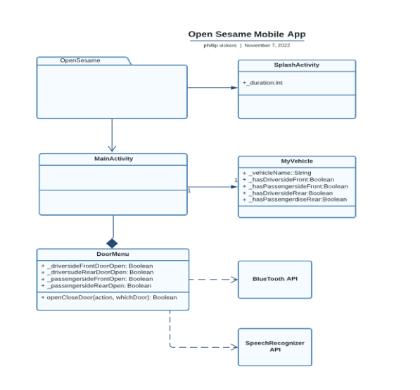
Android App

Slide 10
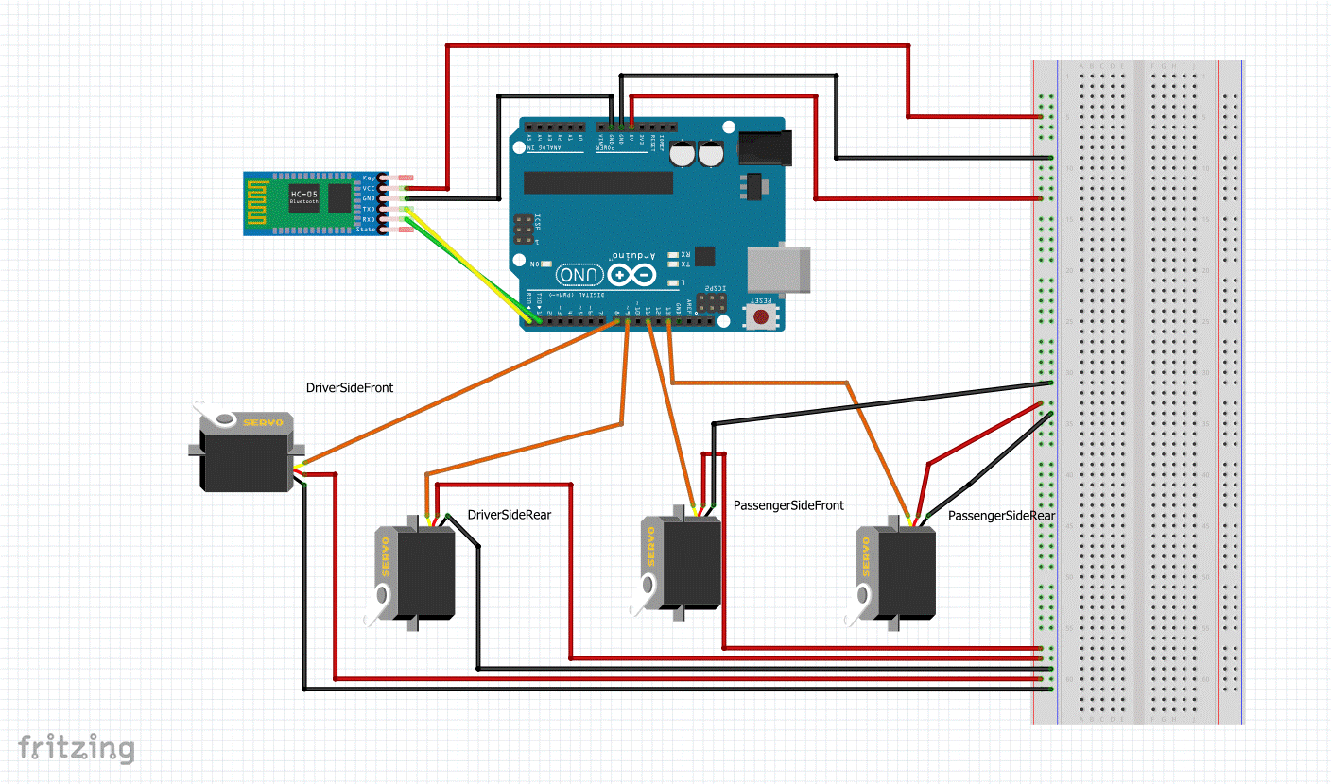
Hardware System
Arduino Uno
4 Servo motor
HC-06 Bluetooth module

Slide 11
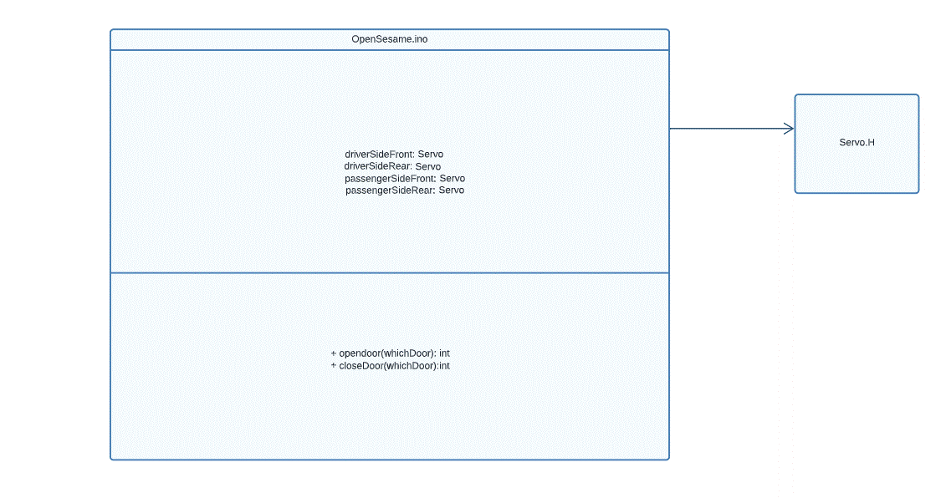
Arduino Code

Slide 12
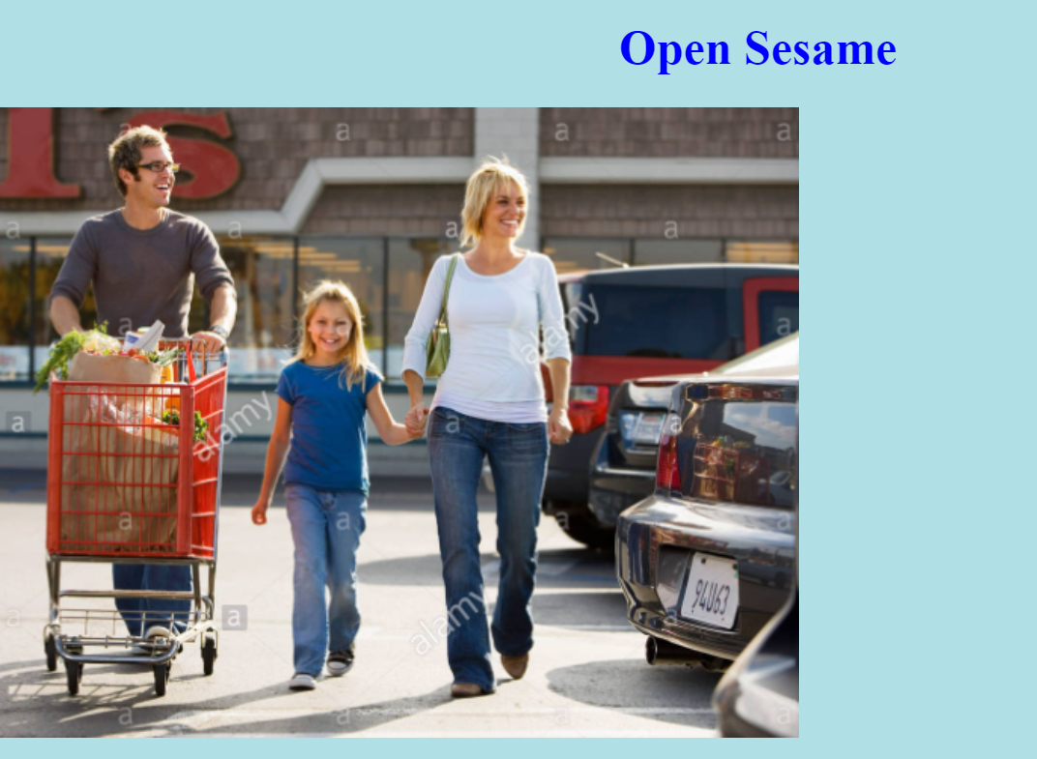
Website
In Process

Slide 13
Any Questions

